Slide 1
AB-InBev Prototype evaluation
By: Utkarsh Vardhan
Email: u.vardhan19@gmail.com

Slide 2
BACKGROUND AND PROBLEM STATEMENT
Product B is the leader in the South African market in terms of power and premiumness.
Recently the brand has been losing power, has lowered media investment and is selling less volume in last few years.
AB Inbev plans on bringing a new recipe to market. The goal of this study is thus to understand how the Current Recipe and new Recipe (Prototype 1 or 2) compare to each other in a direct tasting comparison, in order to assess it’s superiority.
After the Diagnostic Study, it has to be decided that the which product is to be launched.
There are 3 key measures for evaluation - Drinkability, Buying intention, Product Liking and 4 additional diagnostics - Easy drinking, Refreshing, Taste liking, Aftertaste liking.

Slide 3
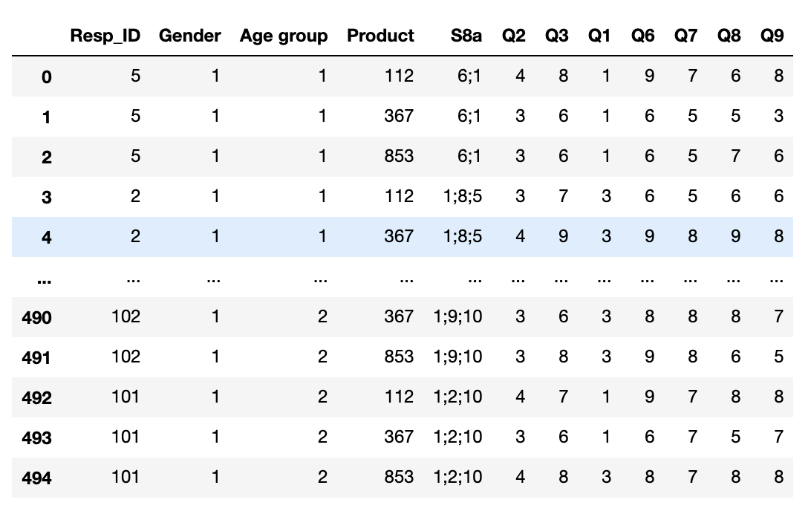
Data Shared
Gender: 1= Male , 2= Female
Age Group : 1= 18 to 34 Years, 2= 35 to 55 Years.
S8a : Demographics states that which beer customer had in last 4 weeks.
Q1 talks about to the Drinkability
Q2 tells the buying intention of the customers.
Q3 to Q9 explore the Product liking , Easy Drinking , Refreshing,Taste Liking,Aftertaste Liking.
Rows: 495 , Columns: 12
Questions have been marked with numbers 1 is dislike and 9 is Like.

Slide 4
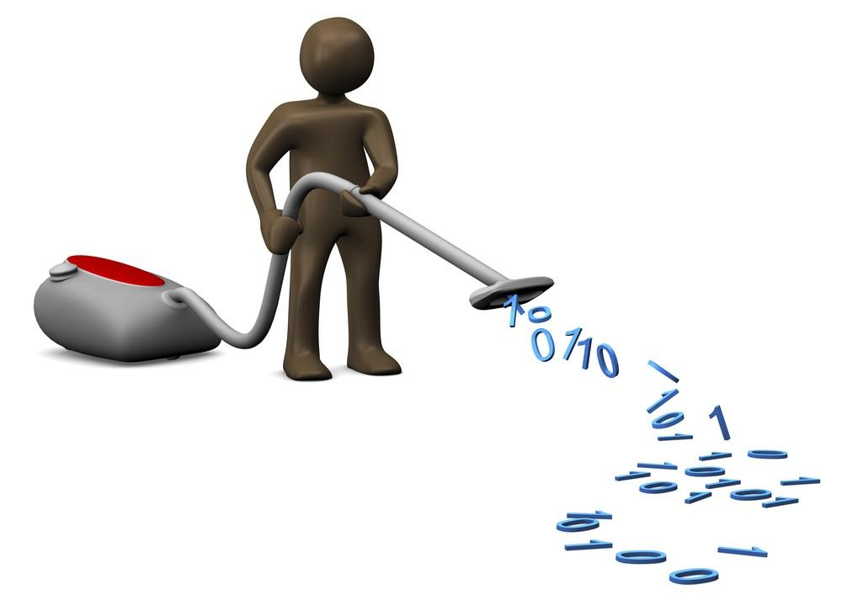
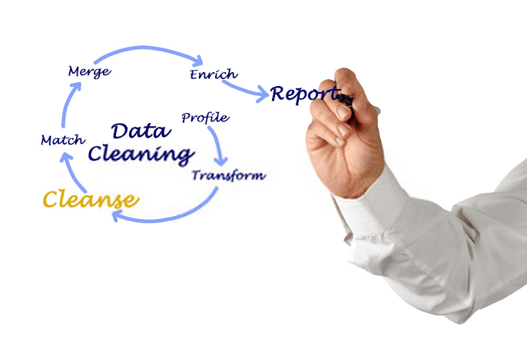
Data Cleaning
Standard-Scaler
Removing Outliers
Checking for correlation Features
Checking Missing Values
Dropping Columns
Checking Uniqueness
Checking Shapes and Data Types

Slide 5
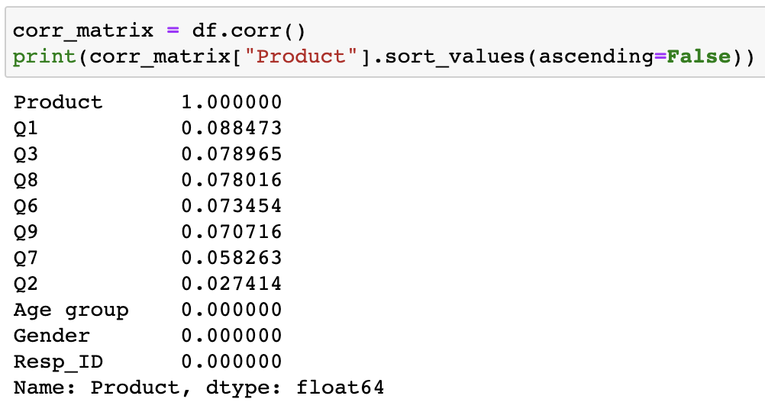
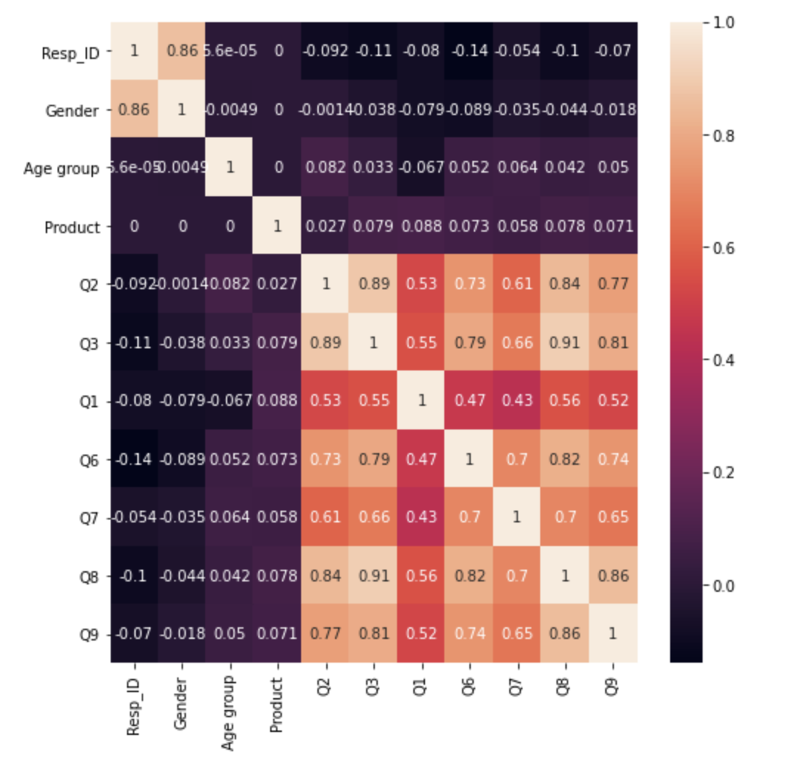
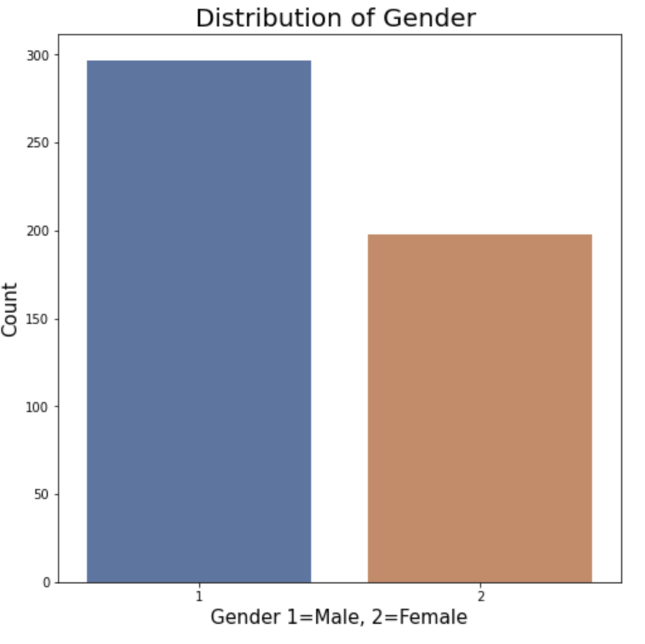
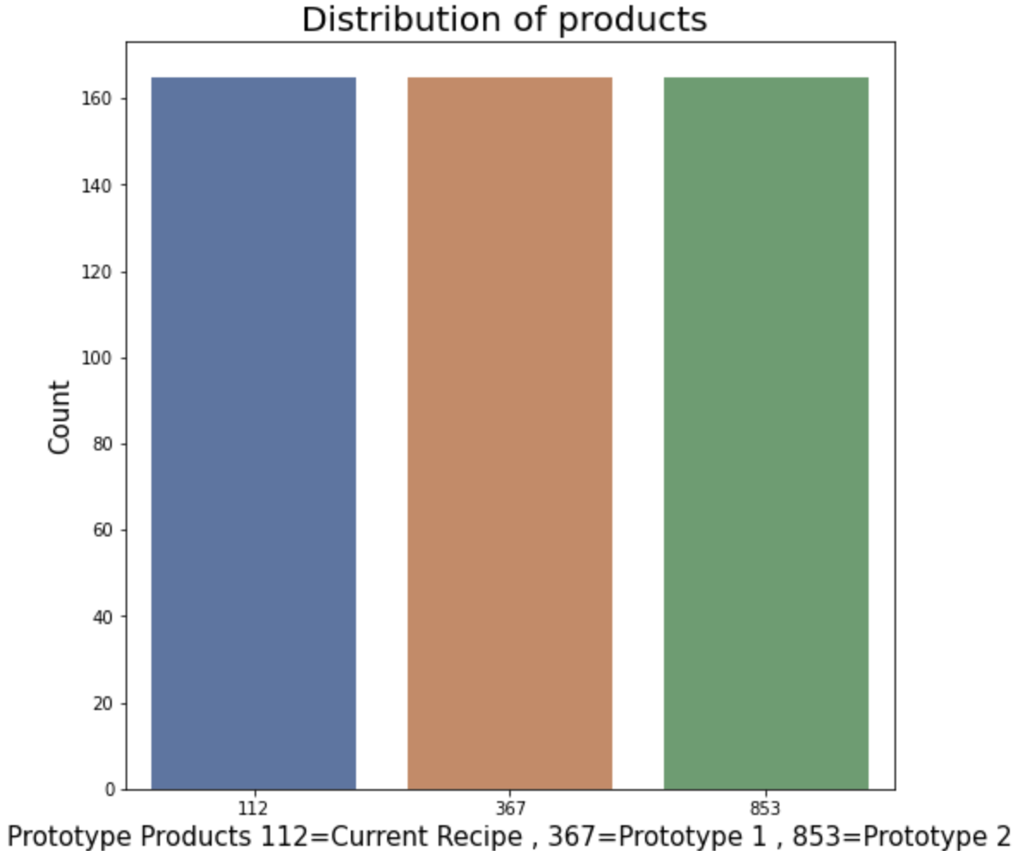
Data Visualization

Slide 6
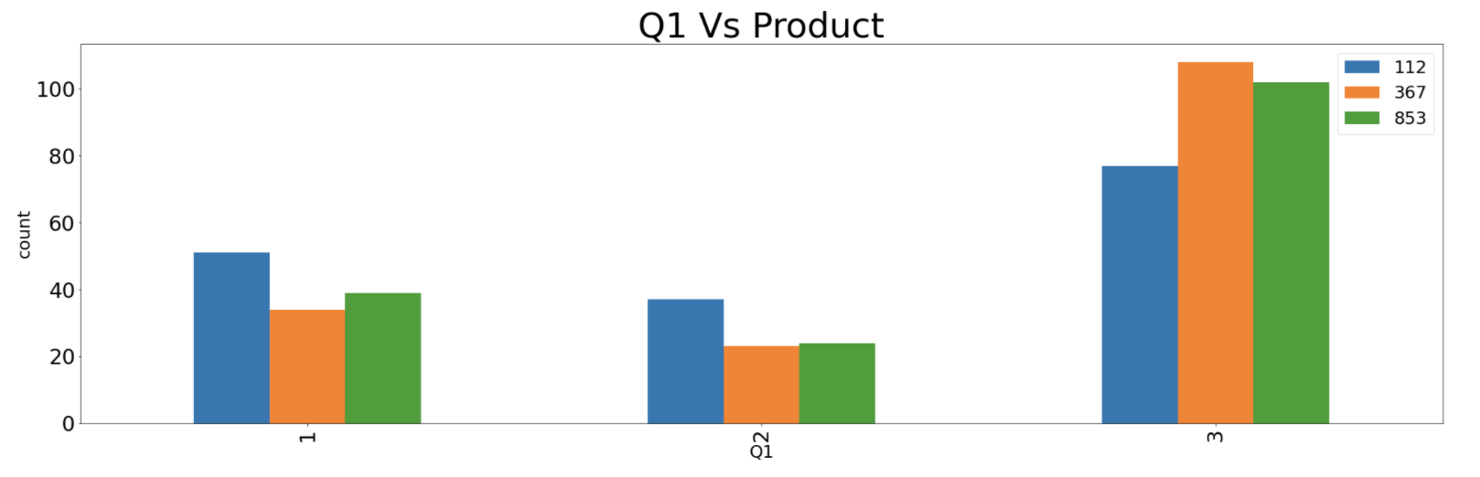
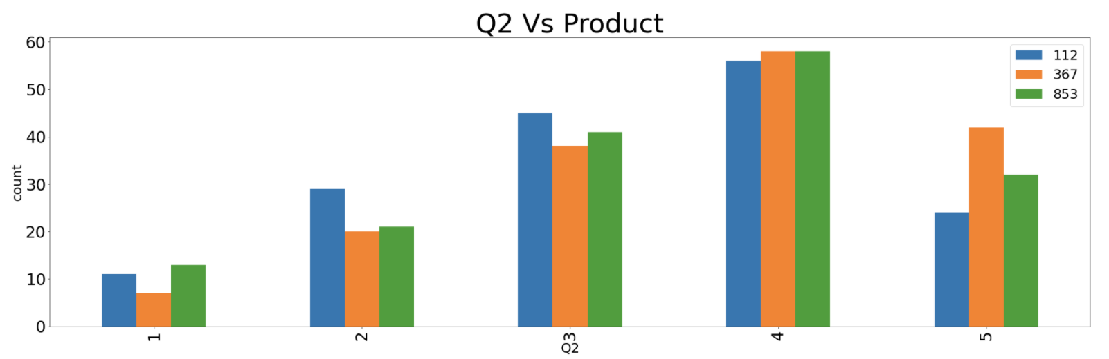
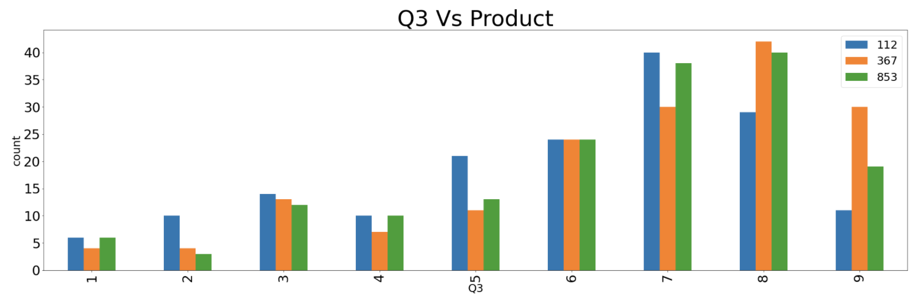
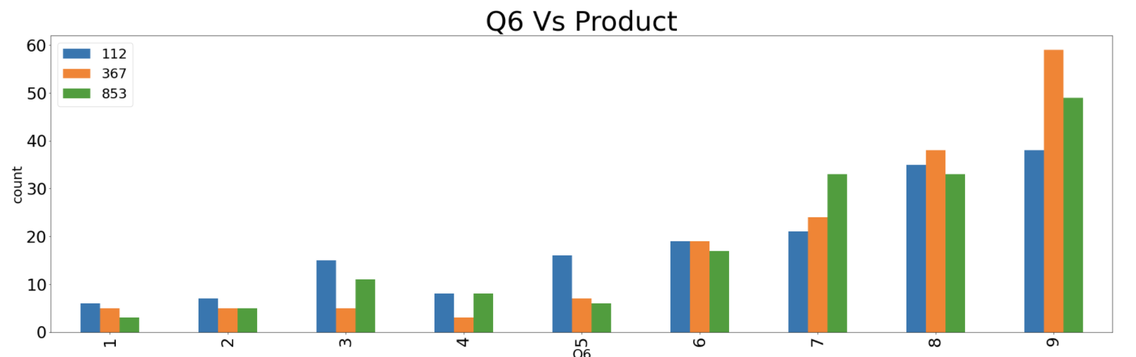
Data Visualization

Slide 7
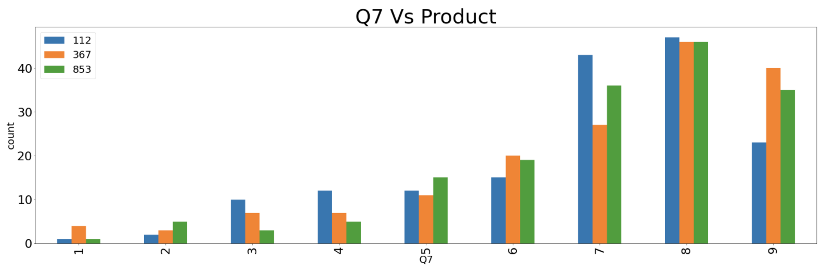
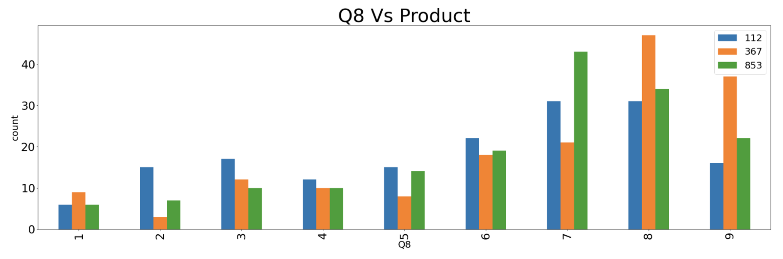
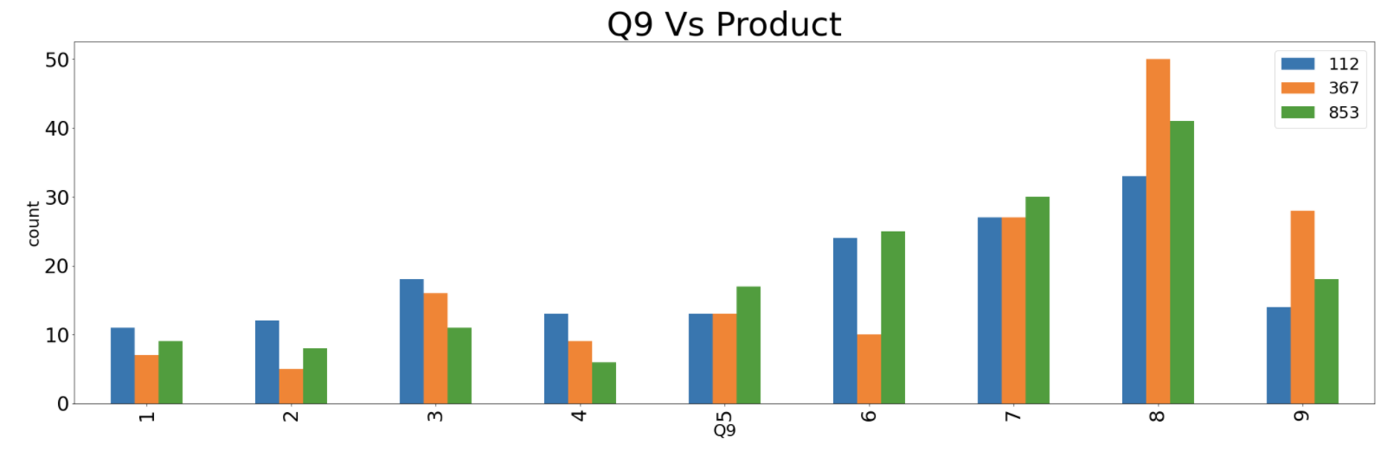
Data Visualization

Slide 8
Result:
MODELS | ACCURACY | CROSS VAL SCORE (sd)
DecisionTreeRegressor | 87.45% | .02
RandomForestRegressor | 82.85% | .012
AdaBoostClassifier | 39.02% | .012
KNeighborsClassifier | 42.85% | .007
GradientBoostingClassifier | 36.58% | .036

Slide 9
Conclusion:
Most of our customer would like to keep drinking Prototype 2 Beer where as We could see that current recipe customers would like to switch the other product.
This Graph helps in understanding if the beer available at the store or bar, Prototype 2 lovers did not had the difficulty in buying the product.
The overall liking of the product is tends towards Prototype 2.
We differ with the product on the ease of the drinking, I could see that mostly people have liked Prototype 2 and accompanied by Prototype 1.
The Beer needs to be refreshing but with the above products , I could see that 112 that is Current Recipe other products have gained more points of refreshment.
The graph shows that how much the customer liked or disliked the taste of the Beer where Prototype 2 shows the most taste liking.
One of the graph shows that how much the customers like or dislike the aftertaste of this beer for all the three products where we could see that prototype 2 is liked and disliked the most.
Hence with all the above conclusions we could determine that Prototype 1 should be launched.
For this case I am going to choose Random Forest Regressor model to do all the prediction as the accuracy is 82.85 % and RMSE is in between 0 and 1 on the lower side which is good.

Slide 10
THANK YOU

